Slide 2
About the campaign
In 2050, an estimated 2 billion people will need assistive technology but only 1 in 20 will have an appropriate device.
In response to the rising rates of disability, ISPO launched the #ISPOWER campaign in 2015 to raise public and decision makers’ awareness and understanding of the transformative power of assistive health technologies and mobility devices in the lives of disabled persons.
In low-income countries, 32-33% of non-disabled people are unable to afford health care compared to 51-53% of people with disabilities.

Slide 3
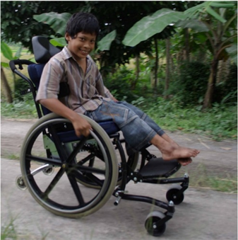
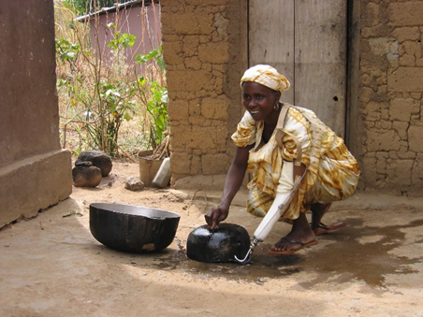
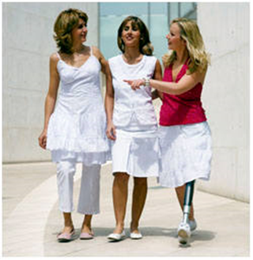
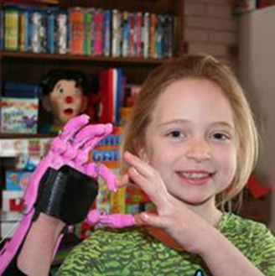
Vision
A world where barriers to social inclusion and mobility are reduced or eliminated as a result of improved access to rehabilitation, mobility devices, and other assistive technology for those who need it.

Slide 4
Mission
Raise public and decision makers’ awareness of the importance of P&O and assistive health technologies (AHT)
Promote the independence and empowerment of people with impaired mobility
Create a global movement and provide a platform around which local and national players can build

Slide 5

International Day of
Persons with Disabilities
Every year, ISPO celebrates the UN International Day of Persons with Disabilities (IDPD) with #ISPOWER to promote the empowerment of persons with disabilities and an inclusive and equal society for all.

Slide 6
Two reasons to participate in the #Ispower campaign

Slide 7
Why participate?
Grow your organisation’s visibility
  More content activity = greater digital presence
  When media or governing committee groups seek input, your organisation will top their lists of who to engage, owing to your digital presence.
Shape the ideas and messages in a way that is favourable to your objectives. Examples:
  Increasing the scope of practice and service delivery
  Coverage by insurers

Slide 8
How can you get involved?

Slide 9
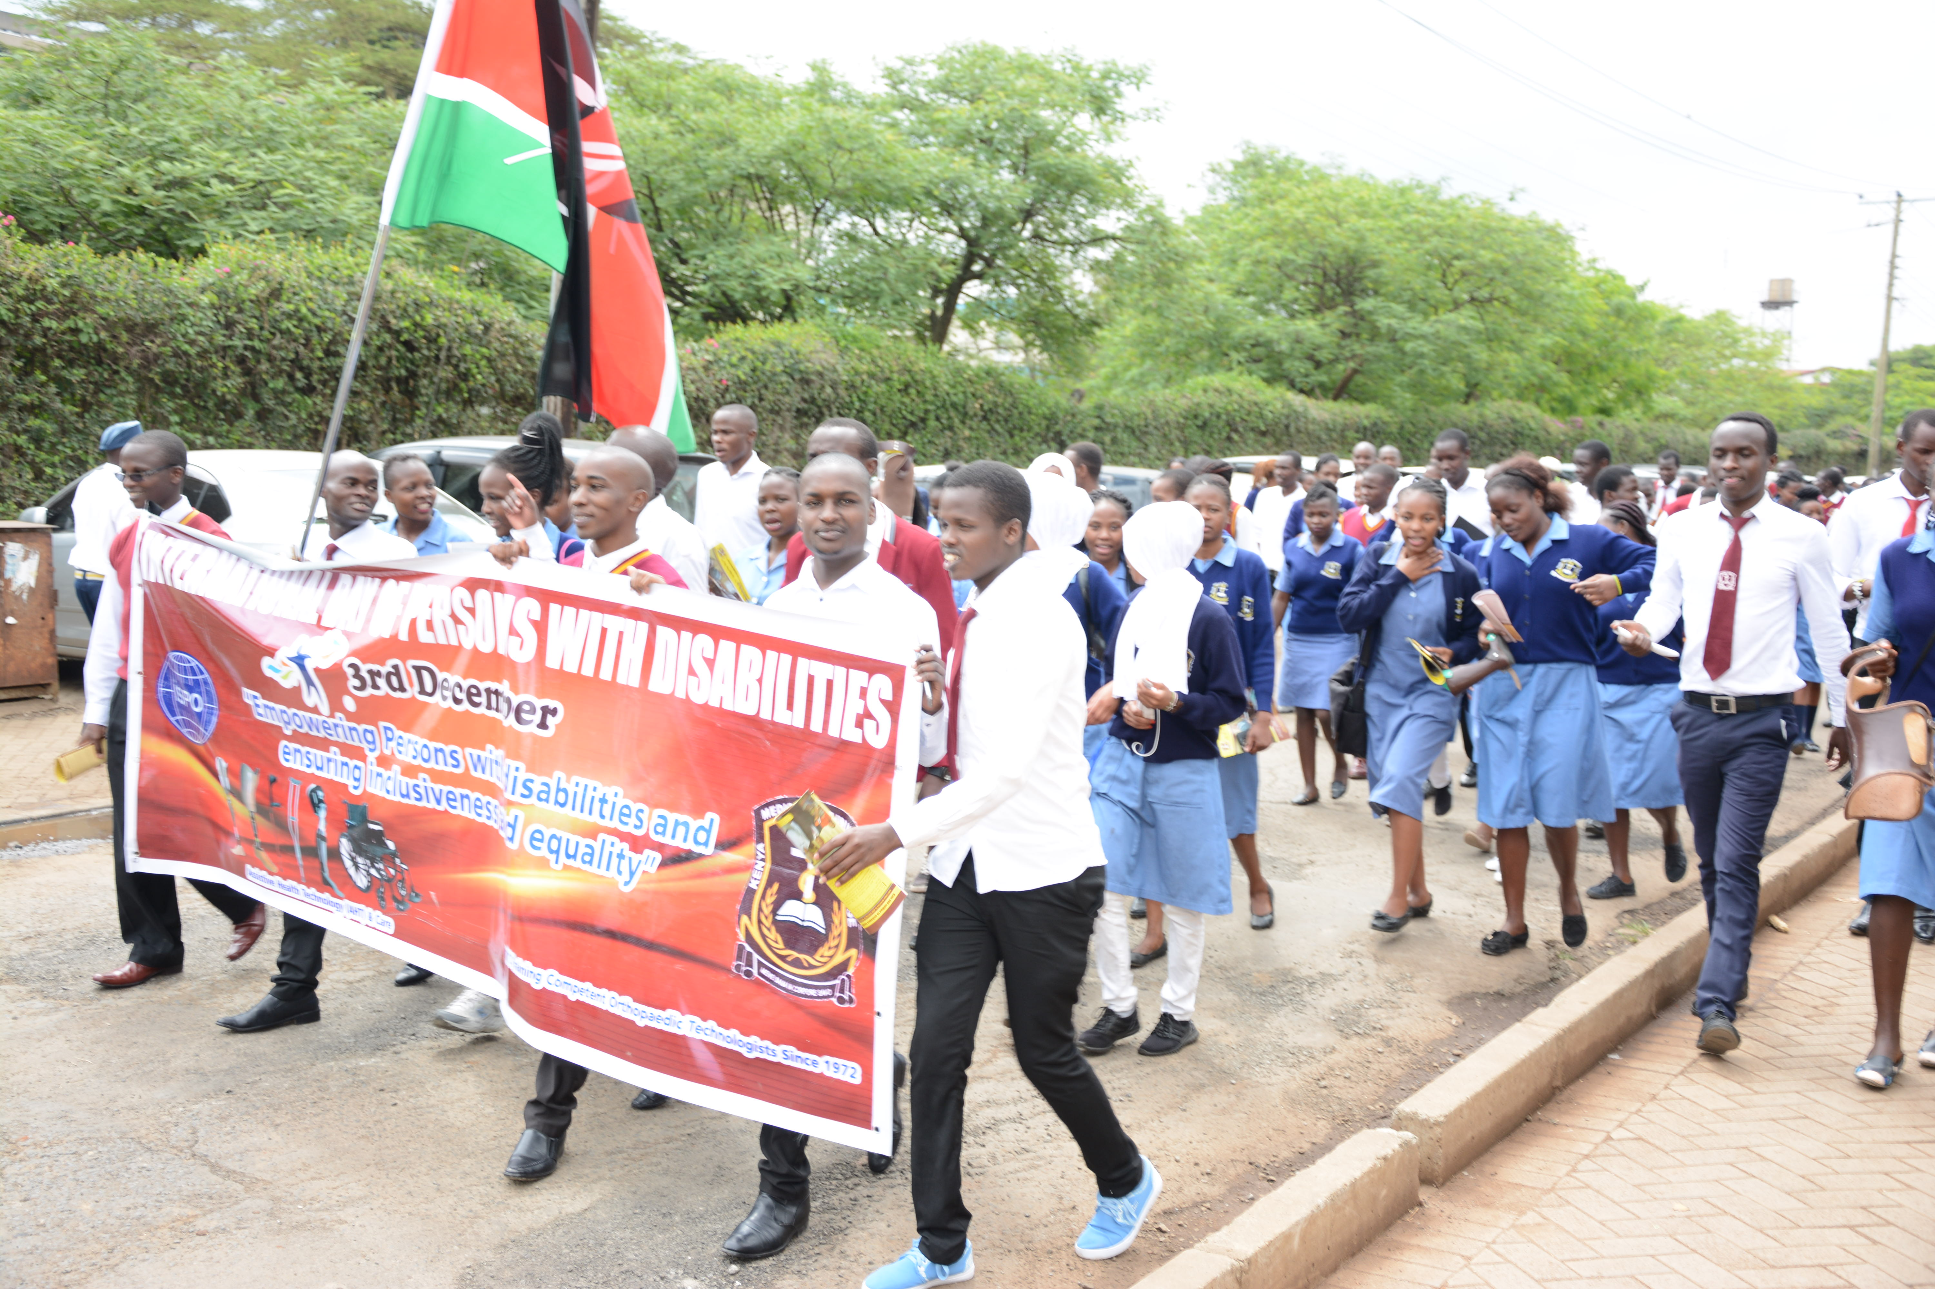
Organise an activity
Promote #ISPOWER by organising an activity with your school, organisation, friends, etc.
Need inspiration? Here are a few suggestions:
Make a human chain
Organise a sports event
Plan an information session
More ideas on www.ispoint.org/GuidanceIdeas

Slide 10
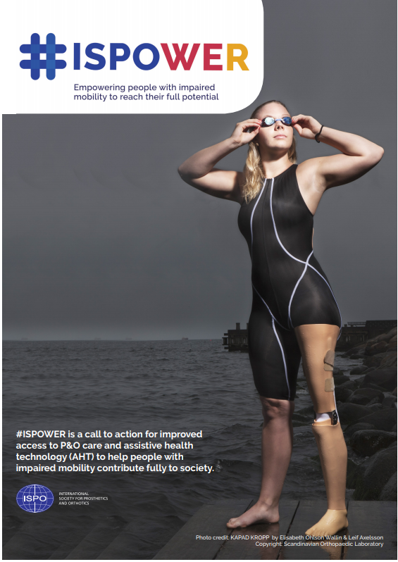
Organise an activity
Make your activity an event not to be missed!
Contact ispo@ispoint.org to advertise your event on ISPO’s channels
Download our amazing campaign materials on www.ispoint.org/CampaignMaterials
Take pictures and videos and share them live on social media and/or with ISPO by submitting your activity report on www.ispoint.org/ISPOWERReport

Slide 11

Spread the word
Share the #ISPOWER message on social media
Follow ISPO on social media and don’t miss the latest news on #ISPOWER
Share ISPO’s posts

Slide 12
#ISPOWER in action
On social media, your organisation can establish a position on an issue, directly (via @handles) or indirectly (via #hashtags). It also allows other interested parties to find and engage with you.
The post: “Over a billion people, about 15% of the world's population, have some form of disability #ISPOWER”, would show up in the results of a search of #ISPOWER.
Tag relevant people in the post to amplify the message (e.g. WHO Director-General @DrTedros).

Slide 13
Take part in the #ISPOWER contest
Each year, ISPO organises a photo contest to celebrate the International Day of Persons with Disabilities. Join us for this year’s celebrations!
Follow us on Facebook to spot the contest announcement
Share your most inspiring picture and testimonial
Encourage your friends and family to vote for you
If you win, your picture will be published on ISPO’s website and social media on IDPD
Good luck!

Slide 14
Join us!
Learn more about #ISPOWER on www.ispoint.org/ISPOWER
Contact ispo@ispoint.org for more information

